Slide 1
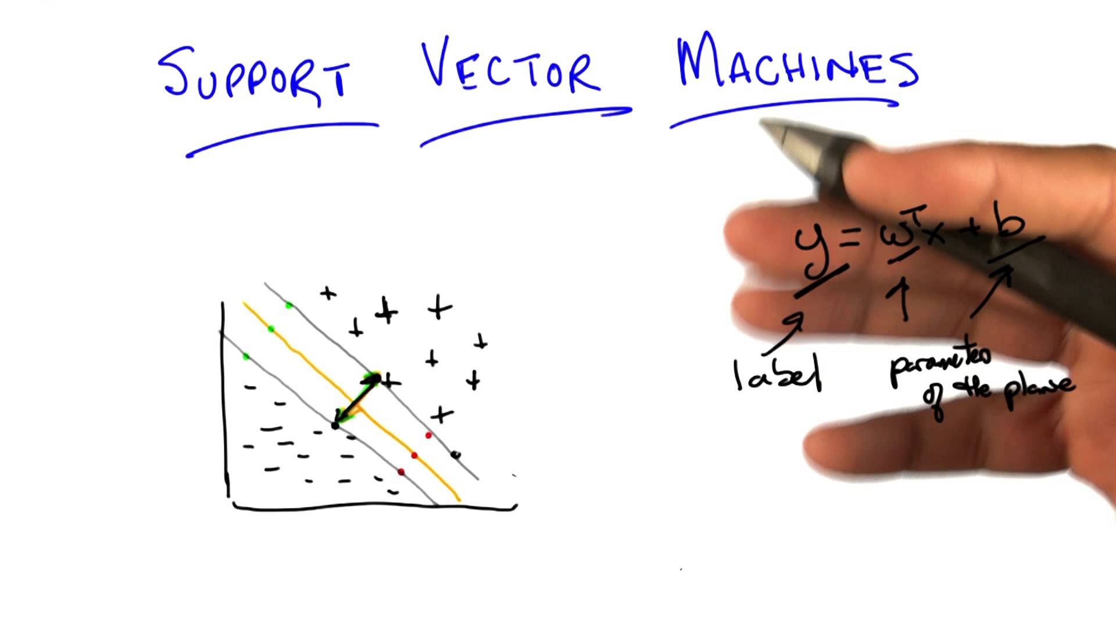
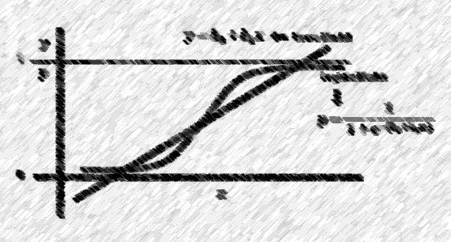
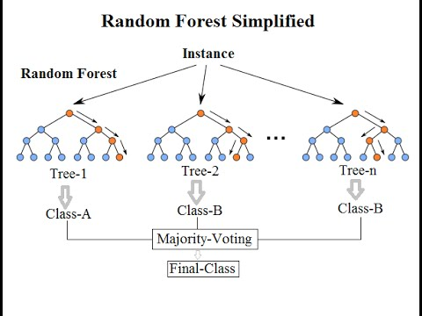
Maximizing bank’s marketing campaign profitability
Through machine learning

Slide 2
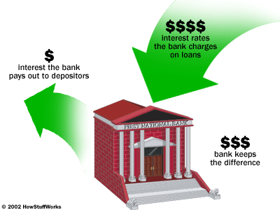
Problem background
Portuguese retail bank marketing long-term deposit offer to existing customers
Long-term deposits
Fixed investment term, usually 1 to 5 years
Safe investments
Very appealing to conservative, low-risk investors
Marketing channel used – Telemarketing

Slide 3
DATA at a gLance
Data Source
Publicly available on UCI website
CSV format
Data from external sources has been used during cost-benefit analysis
Data
Data collected is from May 2008 to Nov 2010
21 attributes and 41188 observations
20 independent variables – client data, call data, socio-economic factors and campaign data

Slide 4
GOAL
Prediction about customers that are most likely to accept term deposit offer
Metric – Campaign profitability
End goal is to Maximize the metric
Test multiple machine learning algorithms and shortlist the one with highest Profitability

Slide 5
EXPLORATORY DATA ANALYSIS
Chi-square
Data Normalization
Multi-collinearity among macroeconomic factors
Principal Component Analysis
Eigen values and scree plot

Slide 6
Machine learning Models
Logistic Regression
Performance on original data
Data rebalancing
Regularization
Model Evaluation
Random Forest Classifier
Regularization
Model Evaluation
Support Vector Machine
Regularization
Model Evaluation

Slide 7
Evaluation Metrics
Profitability
Cost-Benefit Analysis
Profitability= $43*(True Positives) - $11*(True Positives + False Positives)
ROC AUC

Slide 8
BASELINE PERFORMANCE
Conversion rate for this campaign - 11.2%
Out of the total 41188 customers contacted,
4613 accepted offer
36575 rejected offer
Profitability = $43(Total converts)-$11(Total customers contacted)
= $43(4613)-$11(41188)
= $ 1,98,359 - $ 4,53,068
= (- $ 2,54,709)
Overall, this campaign made a loss of $2,54,709
Goal is not only to obtain profits but also to develop a model that can maximize it

Slide 9
Logistic Regression ORIGINAL Imbalanced data
Threshold at which profitability is the highest is: 0.21
Regularization Parameter C : 100
Maximum achievable profitability with the model is: $ 10,159
ROC AUC: 0.7746

Slide 10
Logistic Regression RESAMPLED DATA
 | Upsampled Data | Downsampled Data
Final Regularization parameters | C = 100 | C = 100
Threshold | 0.67 | 0.63
ROC AUC | 0.7783 | 0.7792
Profitability | $ 10,157 | $ 10,114
Profitability at varying thresholds

Slide 11
RANDOM FOREST CLASSIFIER
Threshold at which profitability is the highest is: 0.26
Regularization Parameters
min_samples_leaf = 5
min_samples_split = 10
n_estimators = 50
Maximum achievable profitability with the model is: $ 11,359
ROC AUC: 0.7955

Slide 12
Support vector machine
Threshold at which profitability is the highest is:
Regularization Parameters
Kernel= RBF
C = 0.1
gamma = auto
Maximum achievable profitability with the model is: $ 8,536
ROC AUC: 0.7095

Slide 13
conclusion
 | Profitability | ROC AUC
Logistic Regression | $10,159 | 0.7746
Random Forest Classifier | $11,359 | 0.7955
Support Vector Machines | $8,536 | 0.7095
Random Forest Classifier
Provided an increase in profitability by 104.5 % over baseline model
Campaign profits of $ 11,359 with this model

Slide 14
Future study
Extend study to address
Resource allocation
Manpower planning

